Slide 1

An Intelligent Telepresence Companion System
Rohan rangaraju (22507090)
Ankith Bettaswamy Gowda (22511178)

Slide 2
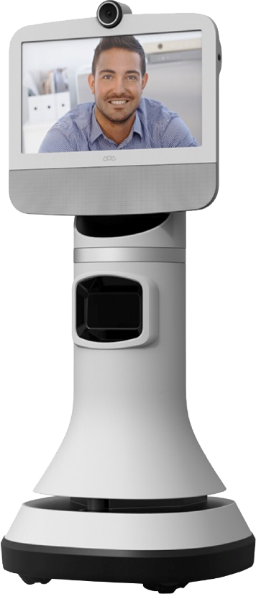
What is Telepresence robot
A telepresence robot is a mobile robot that allows a person to remotely interact and communicate in another location
It uses a camera, microphone, speaker, and screen
Controlled through the internet (via laptop/mobile)
Enables real-time video communication and movement Video - https://www.youtube.com/watch?v=NfYqQ1TmjNw

Slide 3
Problem Statement
Increasing number of elderly people living independently
Limited access to: Continuous monitoring, Social engagement, Immediate support in emergencies
Physical presence of caregivers is not always feasible
Demand for a remote presence and assistance solution

Slide 4


Motivation
Loneliness increases elderly mortality risk by ~30–35%
Social isolation can lead to up to 2× higher risk of death
Many elderly lack interaction, support, and immediate help
Caregivers cannot always be present
Need for a remote companionship & assistance system Source - World Health Organization, National Institute on Aging, Proceedings of the National Academy of Sciences, BMC Geriatrics

Slide 5
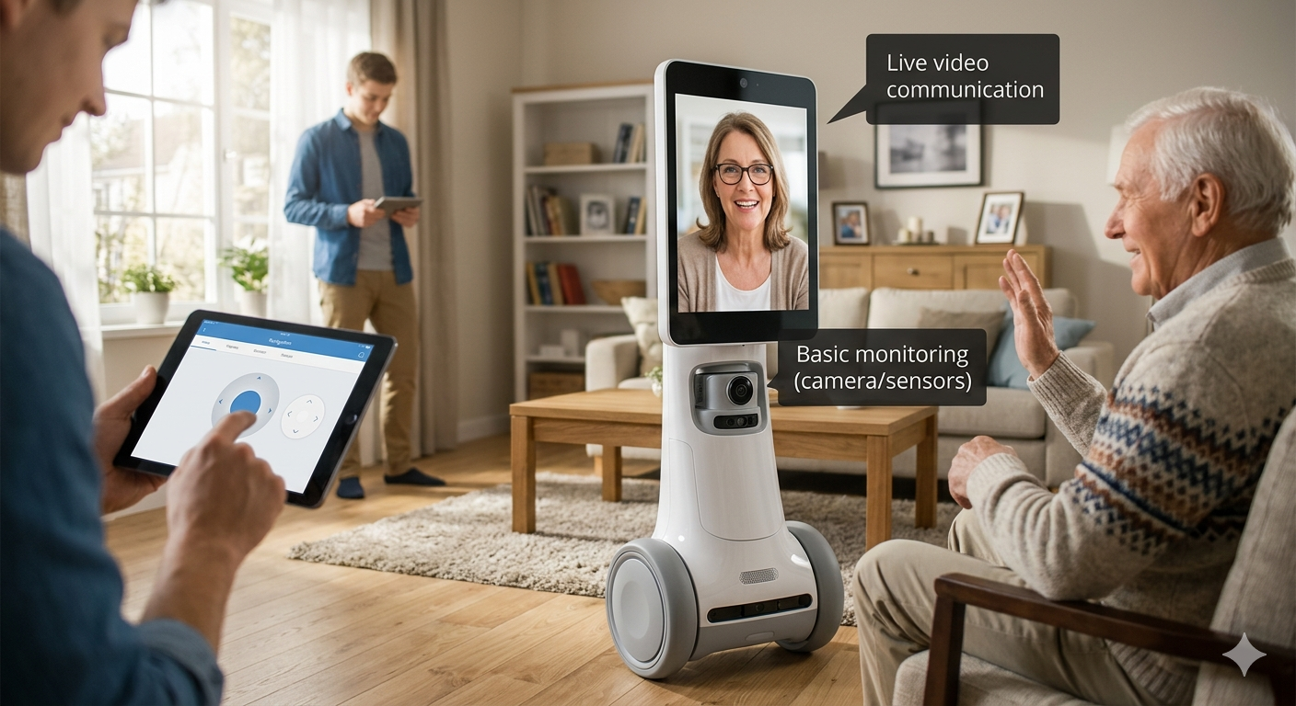
Proposed Solution
A telepresence robot companion
Features:
Live video communication
Remote navigation
Basic monitoring (camera/sensors)
Controlled via mobile/web app

Slide 6
Improvements
Emotion & Health Awareness (AI Assistive Layer)
Problem: Systems don’t understand patient condition beyond video. Improvement: Add AI detection of emotions or basic health signals (e.g., distress)
Home care relies on in-person visits → high cost & delays
Caregivers cannot monitor patients continuously
Existing systems (e.g., Double Robotics Telepresence Robot) provide video only, no intelligence
No real-time understanding of patient emotion or condition
Why Important Now:
Aging population
Shortage of caregivers
Growing demand for remote healthcare solutions

Slide 7
Detects:
Emotion (sad, distress)
Activity (inactivity, unusual behavior)
Voice alerts (“help”)
Smart Alert System → notifies caregiver based on urgency
Improves:
⬇ Response time (≥25%)
⬇ Caregiver workload
⬆ Patient safety & independence
From remote viewing → to intelligent, proactive care.

Slide 8
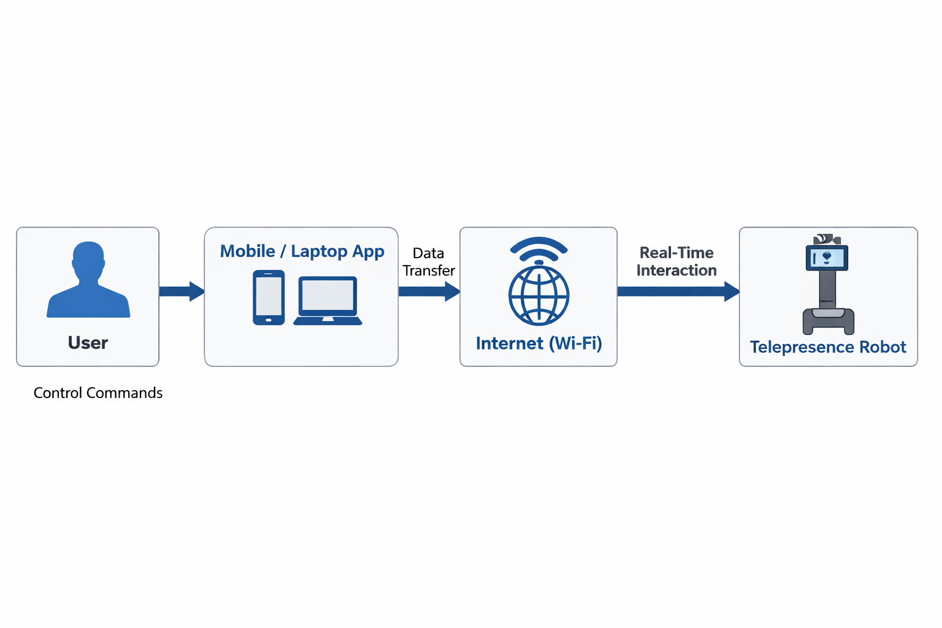
System Overview and components
Raspberry Pi / Jetson Nano
Camera module
Motor driver
Wheels + chassis
Battery
Sensors
Microphone + Speaker
Power Management
Core hardware is implemented with additional modules for communication, interaction, and power management to enable full telepresence functionality.

Slide 9
Tech Stack
Software:
ROS 2 (Robot control)
Python / C++
Web/App interface
Communication:
Wi-Fi / Internet
Video:
WebRTC / streaming tools

Slide 10
BOM (Bill of materials)
Component | Estimated Cost (€)
Controller (e.g., Raspberry Pi / Microcontroller) | 50
Motors (2–4 DC/Stepper Motors) | 30
Camera (Webcam / Pi Camera) | 25
Battery (Li-ion / Power Pack) | 35
Miscellaneous (wires, chassis, wheels, sensors) | 40
Total Estimated Cost | €180

Slide 11
Safety Considerations
Low-speed movement
Obstacle detection (basic)
Stable design (no tipping)
Secure communication (basic encryption)

Slide 12
Expected Outcomes
Telepresence robots can:
Improve elderly care
Reduce caregiver burden
This project builds a practical prototype solution

Slide 13
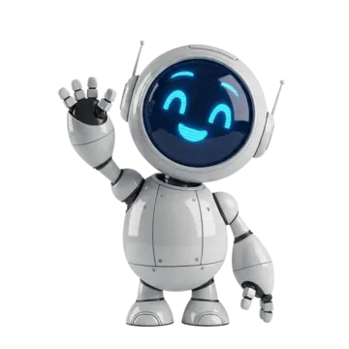
Thank you
Q & A

